Slide 1
CodeU’s
Bootcamp
Chapter 2
Welcome to your 3rd session!
The class will start shortly...
Reproduction and distribution of the presentation deck is prohibited

Slide 2
Agenda for today’s class
Kahoot!
01
02
Homework correction
To recap what was seen last class!
Let’s correct last week’s homework!
Topic of the day:
03
04
Practice time!
-While Loop
Let’s practice with some coding exercises!
Wrap-up
Conclusion
05
06
CodeU Robot
Summary of what we’ve learned today
homework and questions

Slide 3

Time for Kahoot!
Head over to Kahoot.it for a fun coding quiz!

Slide 4

Homework Correction: List Puzzle!
Homework Description
You must transform an Initial list into the Final list using the list manipulation methods you have learned in class!
Initial List
["Nissan", "Toyota", "Mercedes", "Tesla", "Volvo", "Audi"]
Final List
["Nissan", "Mercedes", "Porsche", "Dodge", "Tesla", "Audi", "Ferrari"]
Correction
initial_list = ["Nissan", "Toyota", "Mercedes", "Tesla", "Volvo", "Audi"]
initial_list.remove(initial_list[1])
initial_list.insert(2, "Porsche")
initial_list.insert(3, "Dodge")
initial_list.remove(initial_list[5])
initial_list.append("Ferrari")
print(initial_list)

Slide 5
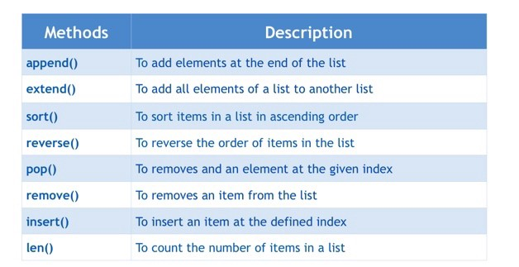
Review of List methods
To remove and add an element at the given index

Slide 6
Introduction to While Loops
What is a LOOP?
A loop is a sequence of instructions that is continually repeated until a certain condition is reached.
Example
You ask your mom to buy chips. She says no. You keep asking until she says yes. Once she says yes, you stop asking. The condition here is that she says yes!
Syntax for While loops
while mom == “No”:
print(“Can we please buy some chips”)
**In this scenario, once the mom’s answer is anything other than “No”, the loop stops. If the mom keeps answering “No”, the loop will continue and the print() statement will be repeated.

Slide 7
Let’s practice!
Example 2
i = 10
while i>1:
print("Hello World")
i = i - 1
01
02
03
Example 1
i = 0
while i<5:
print(i)
i = i + 1
Example 3
answer = input("Can we go to the movies? ")
while answer == "no":
answer = input("Can we go to . the movies? ") print("Yay, thank you!")
04
Let’s build a list of numbers!
list = []
number = 0
while number != 10:
number = number + 1
list.append(number)
print(list) print(“The final list is: “ + list)

Slide 8
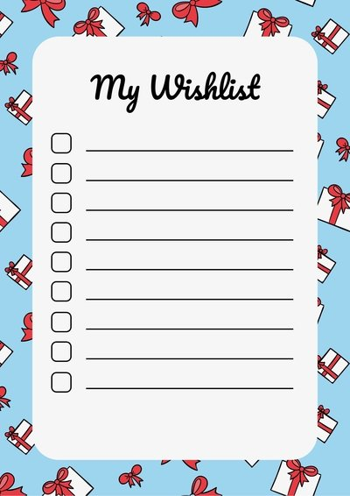
Homework: Create a Wish List!
Homework Description
For this week’s homework, you will build a Wish List Maker for anyone that would like to make a list of presents they would love to receive in the future!
1
You must create an empty list where each gift will be added
4
Create a WHILE Loop that ends once the list LENGTH is equal to 5.
2
You must define a variable using INPUT(). This is where the user is asked what present they would like to add to the list.
5
Print() the completed list to the user
3
The list can contain only 5 items.

Slide 9




Thank you!
Does anyone have any questions?
Next class: Class 4
Please contact us if you have any questions or if you want to notify us for anything.
Phone:
(438) 391-9106
Email:
hello@codeu.ca

